Slide 1
Patient Information Management System
Nikom Suwankamol 51051182 Patcharaporn Munchupaiboon 51051184
Palat Chantawannop 5105205
Computer Science (International Program) Faculty of Science, KMITL
Advisor : Dr. Warangkhana Kimpan

Slide 2
Outlines
Project Progression
Demonstration
Limitation
Conclusion

Slide 3
Project Progression

Slide 4
Project Progression
User Interface Improvement
Login system
Administrator system
Graphical Drawing (Canvas)
Report

Slide 5
Main functions
Two main functions used in neurological department
Cranial Nerves
Neurological Observation

Slide 6
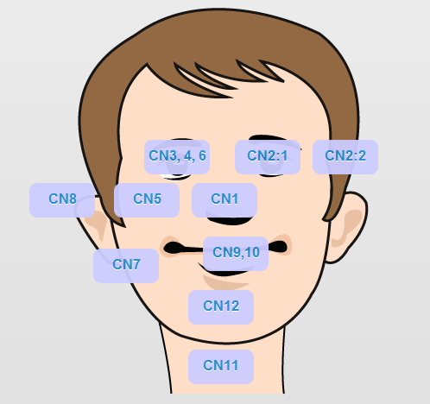
Cranial Nerves
Used in recording the symptoms of twelve pairs of cranial nerves.

Slide 7
Neurological Observation
Used in recording the neurological observation symptoms
Coma Scale
Vital Signs
Motor Power

Slide 8
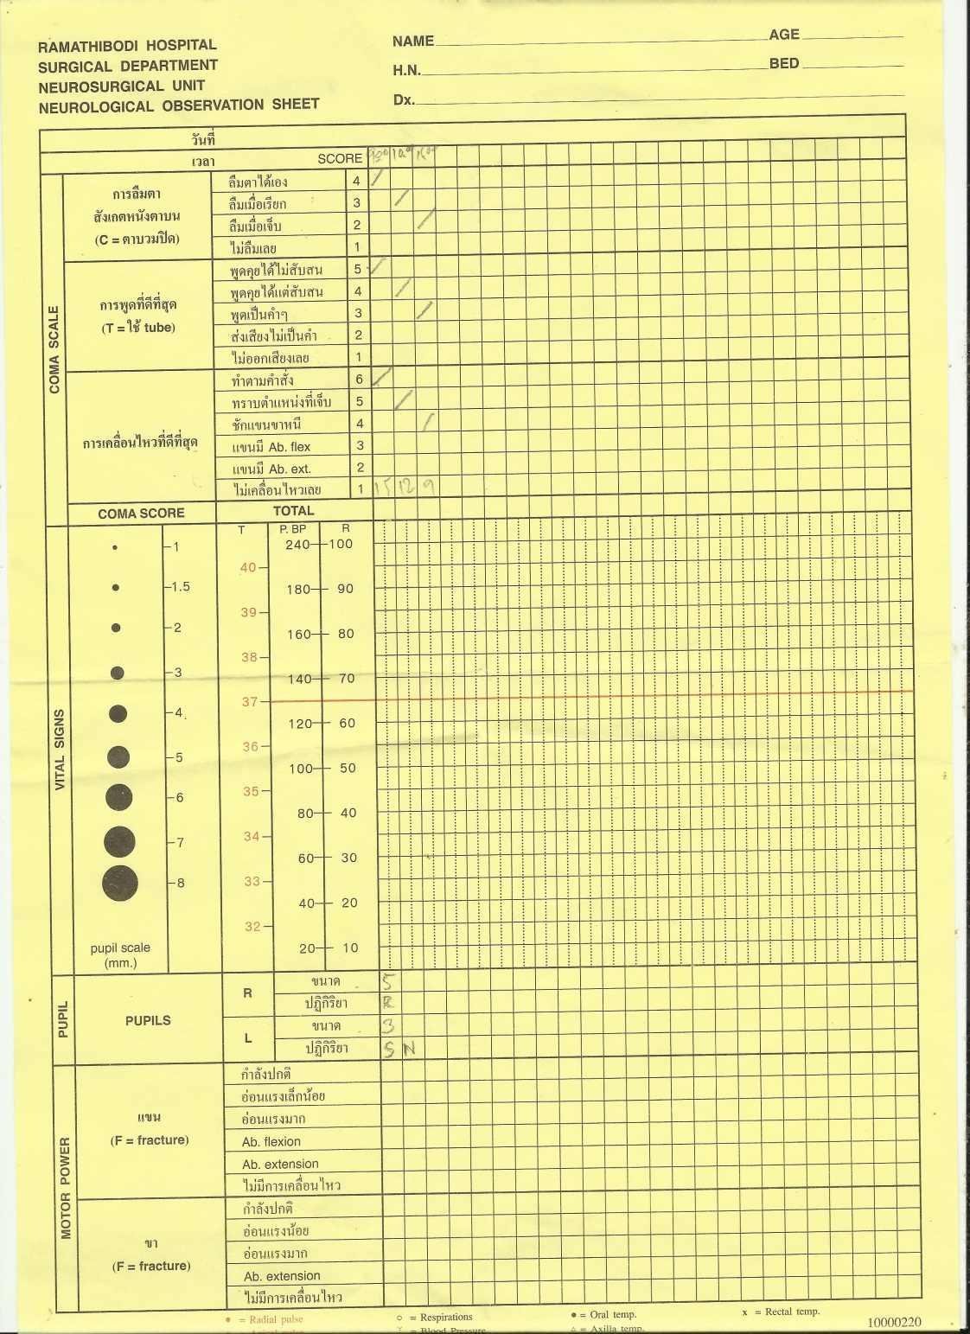

Slide 9
Limitations

Slide 10
Limitations of This Special Problem
Canvas
The picture drawing could not only be replaced from png with encode-64 bit to canvas.
Can only export to .png, .jpeg, .gif
The drawing was not so smooth.
Function .toDataURL() does not support on Android 2.x or below
Reference: http://code.google.com/p/android/issues/detail?id=7901

Slide 11
Limitations of This Special Problem
The position of layout was suitable only when opening in landscape mode.
The web application was suitable only with MySQL database.
The web application can only run on MySQL UNIX socket
The sessions have the time limitation.

Slide 12
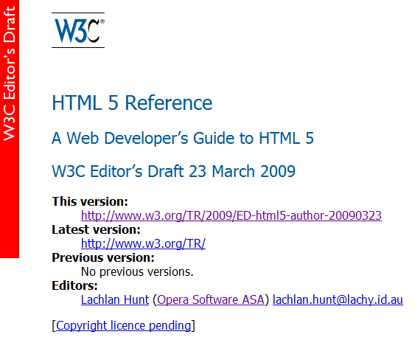
Limitations of This Special Problem
The HTML5 have been stilled a draft version since 2010

Slide 13
User Interface

Slide 14
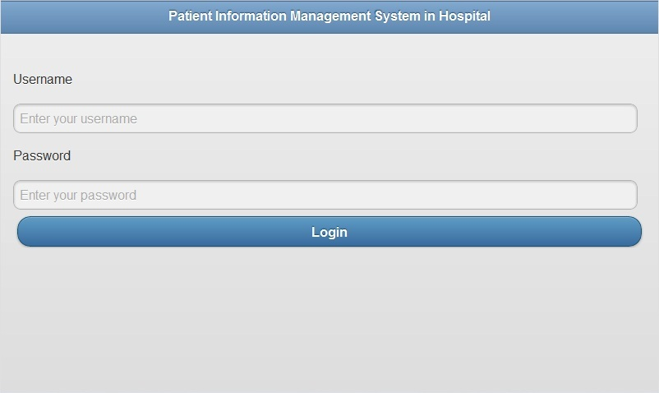
Login Page

Slide 15
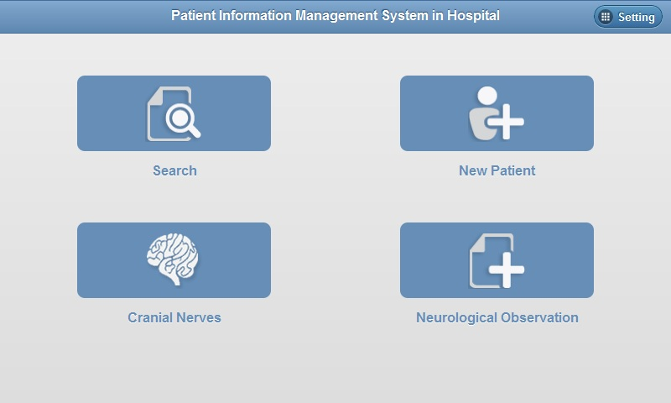
Main Page

Slide 16
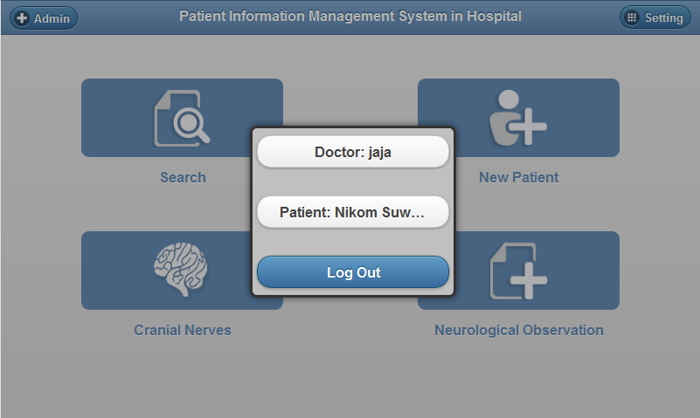
Setting

Slide 17
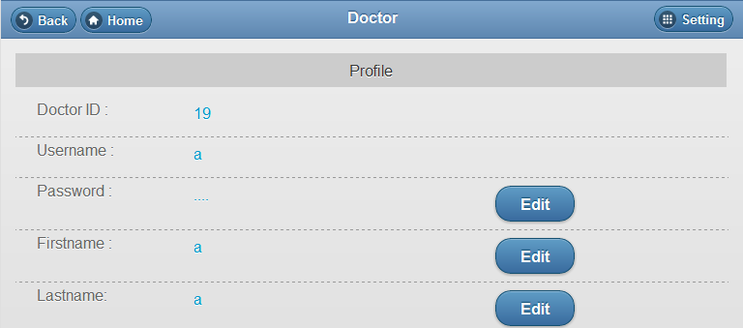
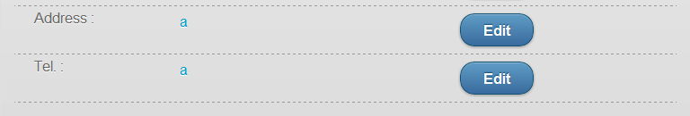
Doctor Profile

Slide 18
Search Patient

Slide 19
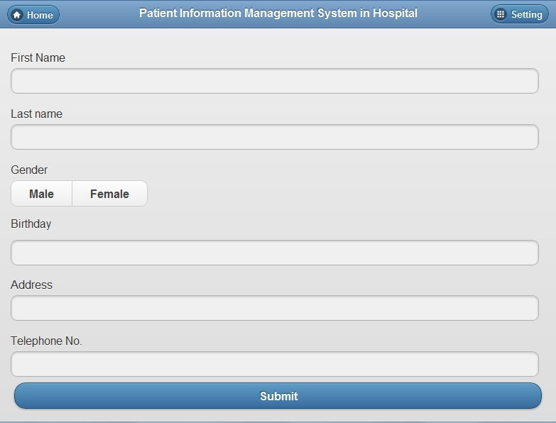
Add New Patient Profile

Slide 20
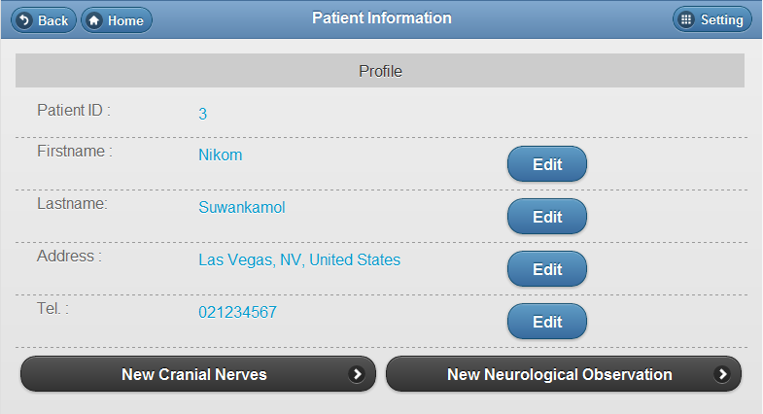
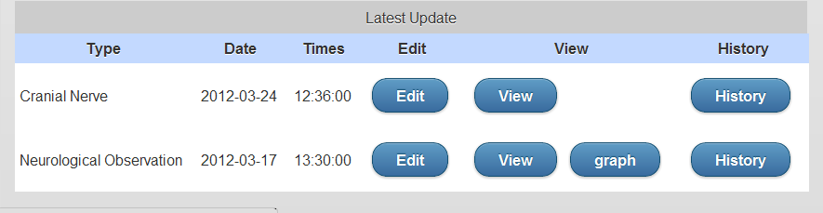
Patient Information

Slide 21
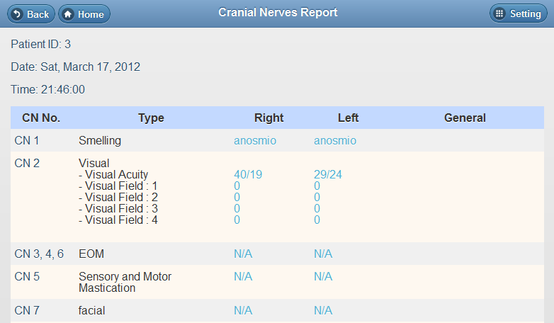
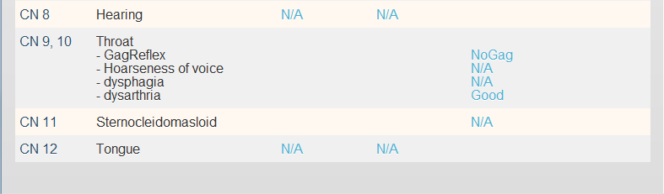
Cranial Nerves Report

Slide 22
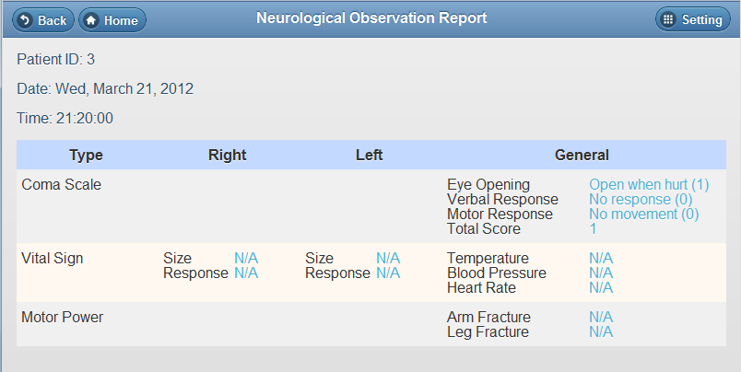
Neurological Observation Report

Slide 23
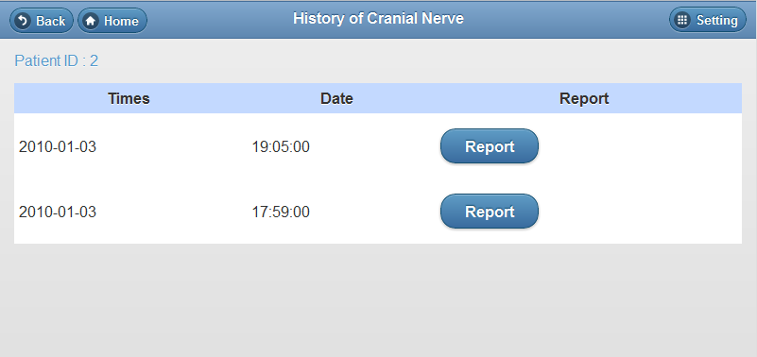
History of Cranial Nerves

Slide 24
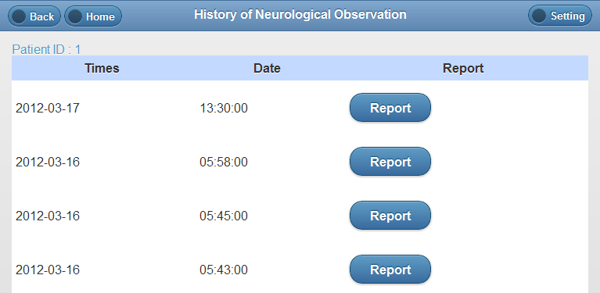
History of Neurological Observation

Slide 25
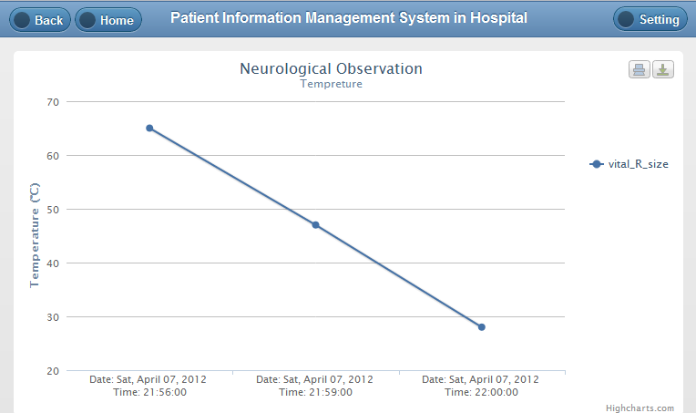
Temperature Graph

Slide 26
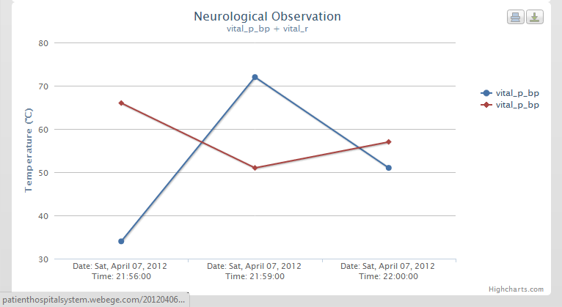
Vital Signs Graph

Slide 27
Cranial Nerves

Slide 28
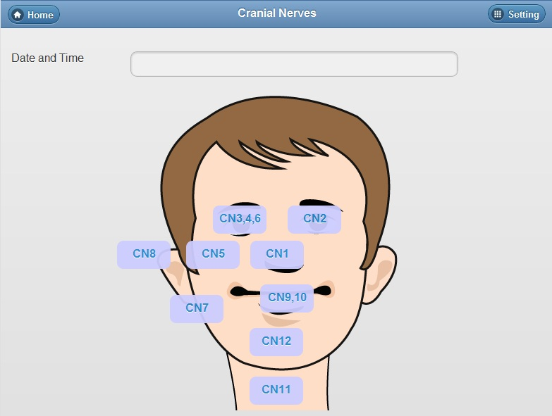
Main Cranial Nerves Pages

Slide 29
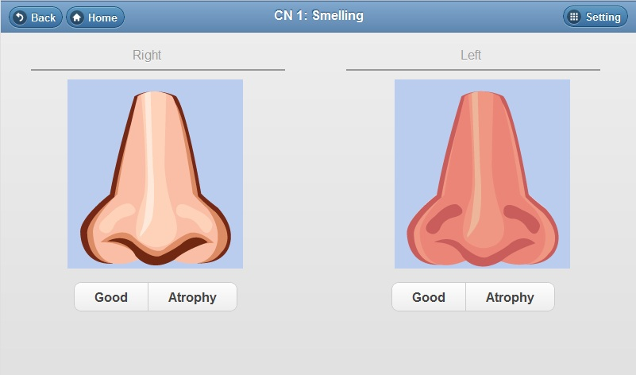
CN 1: Smelling

Slide 30
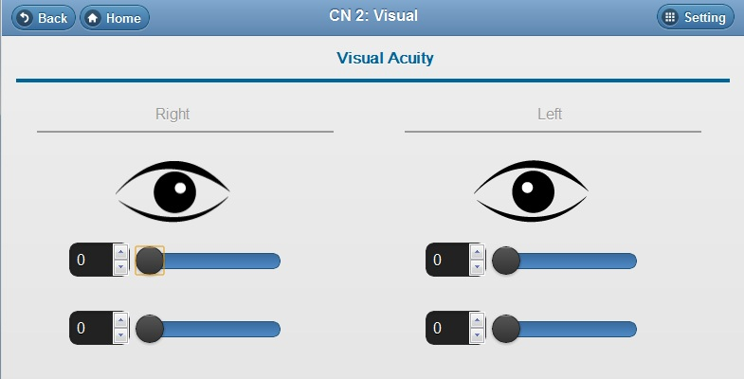
CN 2: Visual

Slide 31
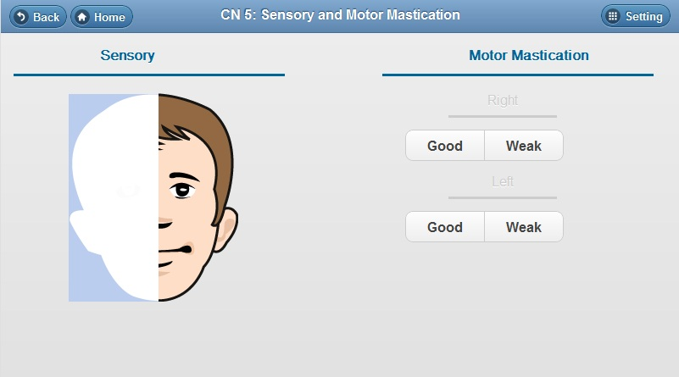
CN 5: Sensory and Motor Mastication

Slide 32
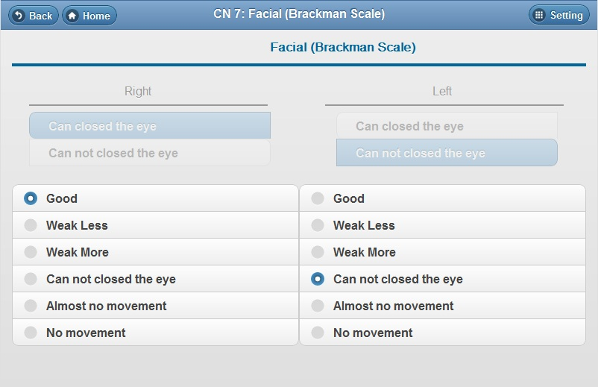
CN 7 : Facial(Brackman Scale)

Slide 33
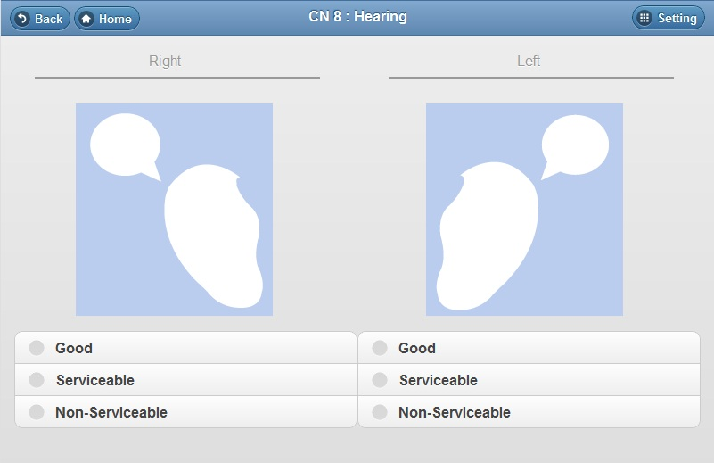
CN 8 : Hearing

Slide 34
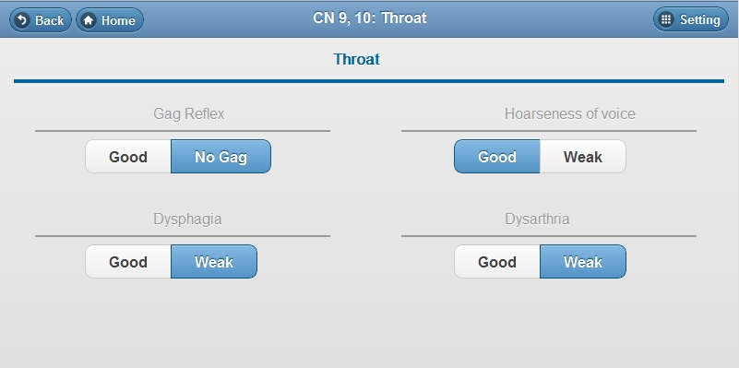
CN 9,10 : Throat

Slide 35
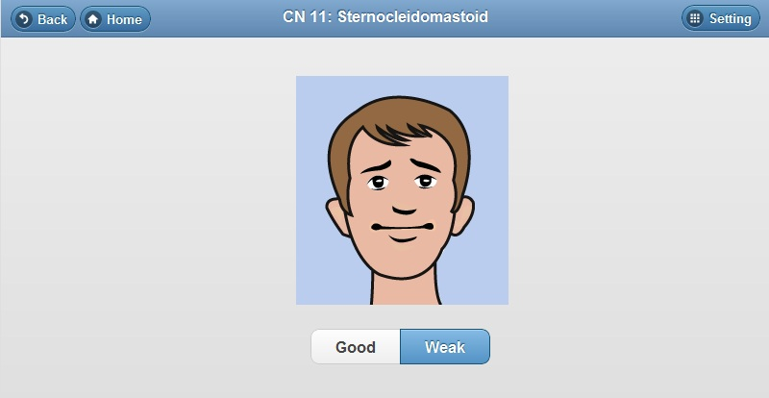
CN 11: Sternocleidomastoid

Slide 36
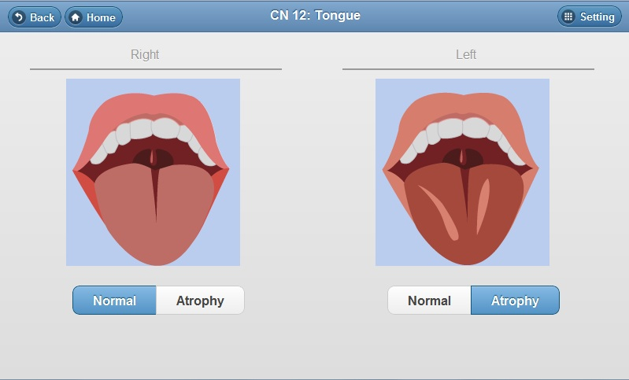
CN 12: Tongue

Slide 37
Neurological Observation

Slide 38
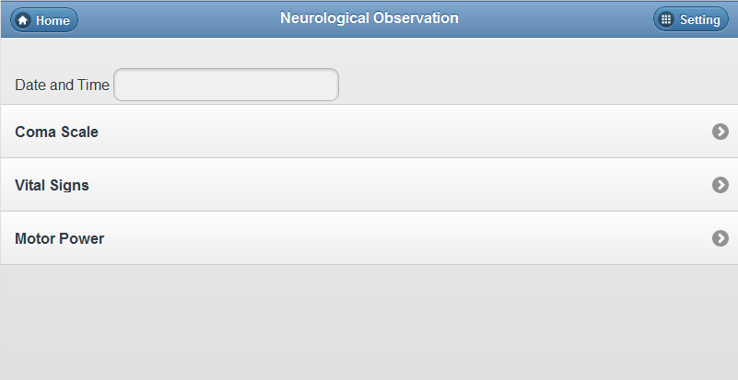
Main Page of Neurological Observation

Slide 39
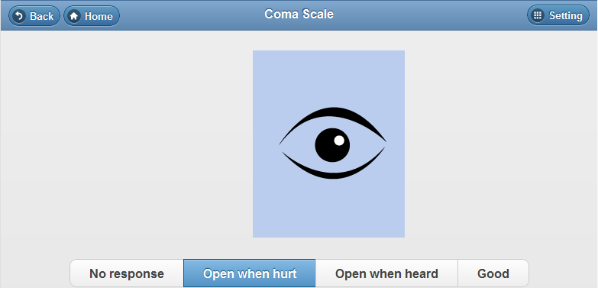
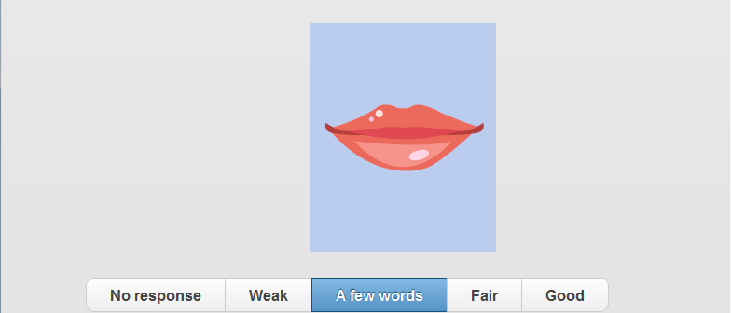
Coma Scale

Slide 40
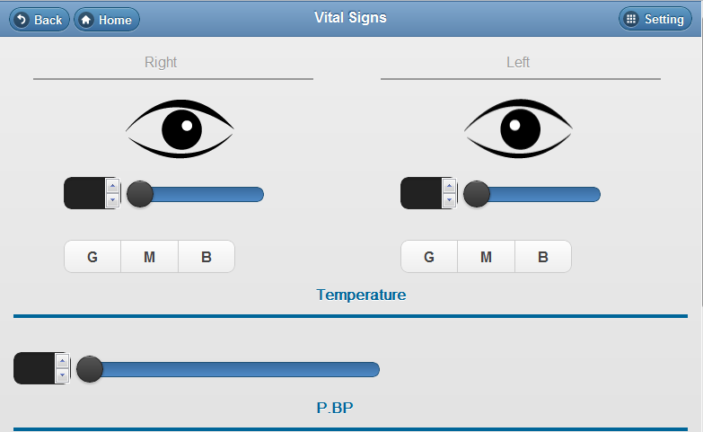
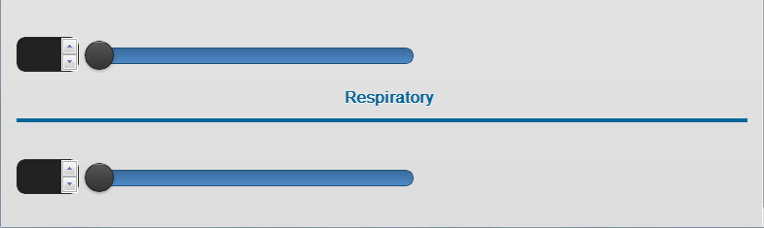
Vital Signs

Slide 41
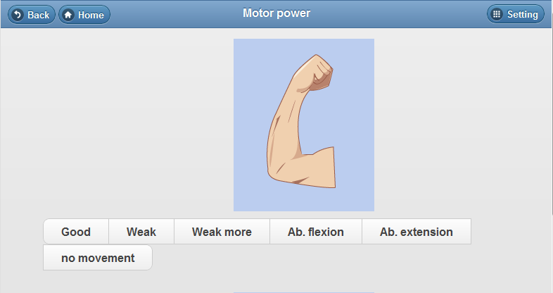
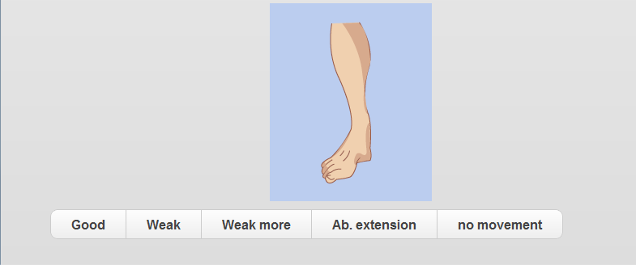
Motor Power

Slide 42
Administrator Interface

Slide 43
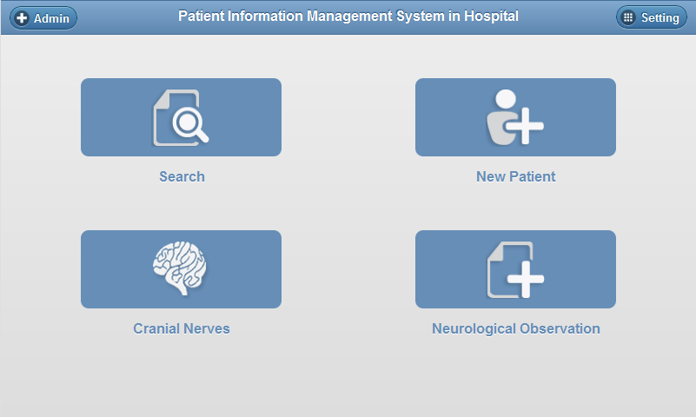
Main Page

Slide 44
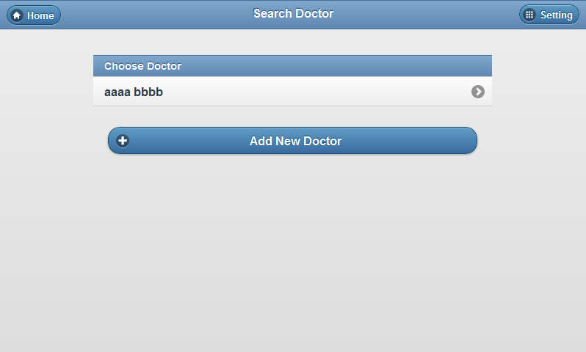
Search Doctor Page

Slide 45
Conclusions
The system focuses on the important functions that are necessary for the doctors.
For example, the functions that used to record the symptoms
Cranial Nerves
Neurological Observation

Slide 46
Conclusions (Cont.)
The web application was developed in order to make it easy for the users to use the system with tablet PCs.

Slide 47
Demonstration

